Slide 1

Flow Overstack Group
Software Atelier 2 – Human-Computer Interaction
Università della Svizzera Italiana
Main sponsor

Slide 2
Idea
Good stuff
Not bad stuff

Slide 3
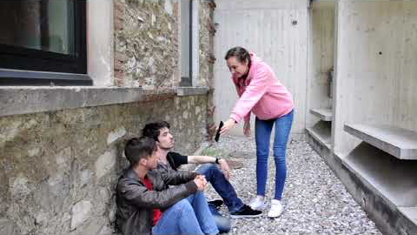

Slide 4
Thank you for your attention!
“Stay hungry, stay V.I.P.”
-Kathrin
“Damn, I’m dying”
-Tommaso

